Slide 1



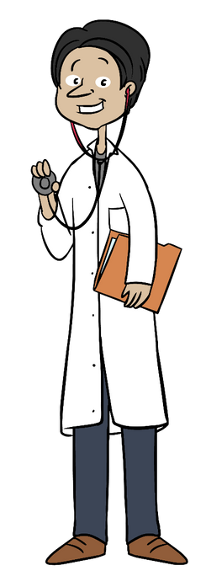
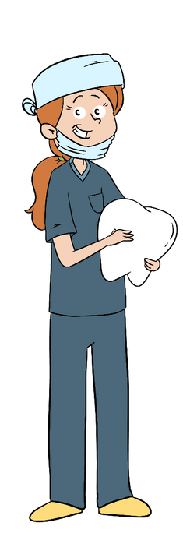
Career Research
pEnNaNt PrOjEcT
A fun research project for students to display the research they did about a career of choice.

Slide 2

My Career Research
Career I’m researching:
______________________________________________________
Similar Careers
What is the average starting salary?
What is the median salary? What is the job outlook?
Do I need to go to
college? What
degree is needed?
Whatare the job
skills needed to do
this job?
What does a typical day look like?
What are my
thoughts about this
career? Is this a
career I am
interested in?
©Carol Miller 2019

Slide 3

My Future Career
Career Cluster:
Average Starting Salary:
__________________________
__________________________
Skills Needed:
Training/Education Needed:
__________________________ __________________________ __________________________ __________________________ __________________________
__________________________ __________________________ __________________________ __________________________ __________________________
Why I am Interested in this career:
Job Outlook:
Good
Declining
On the Rise
A Typical Day Looks Like
__________________________
__________________________
__________________________
__________________________
__________________________ __________________________ __________________________ __________________________ __________________________ __________________________ __________________________ __________________________ __________________________ __________________________
Similar Careers:
_______________________________________________
________________________________________
_______________________________
_______________________
________________
Complete the pennant then cut on the dotted line.
©Carol Miller 2019

Slide 4

My Future Career
By:
__________________________

